Slide 1

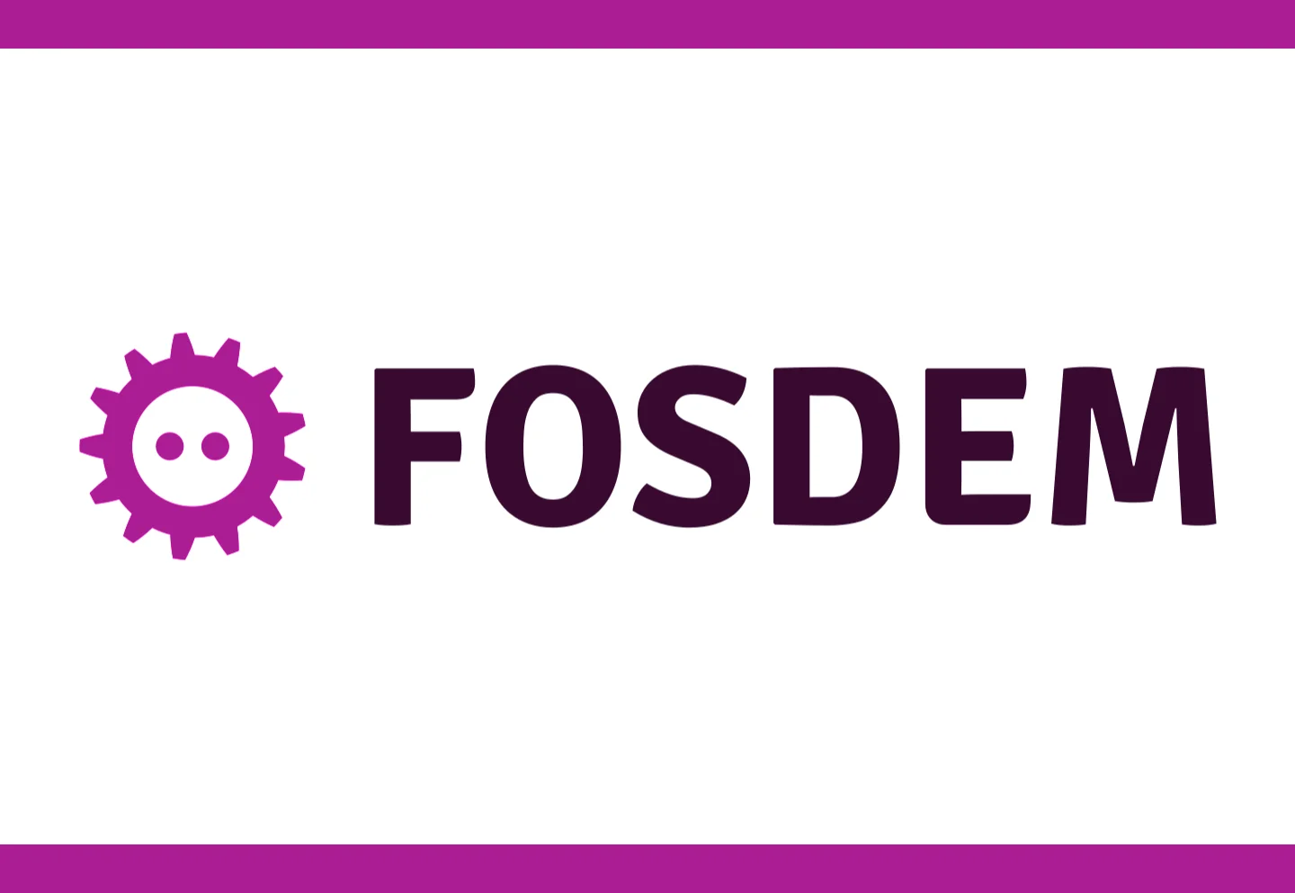
CRA by Design Protocol-Embedded Compliance for EV Charging Infrastructure
Achim Friedland // GraphDefined GmbH
31. January 2026

Slide 2
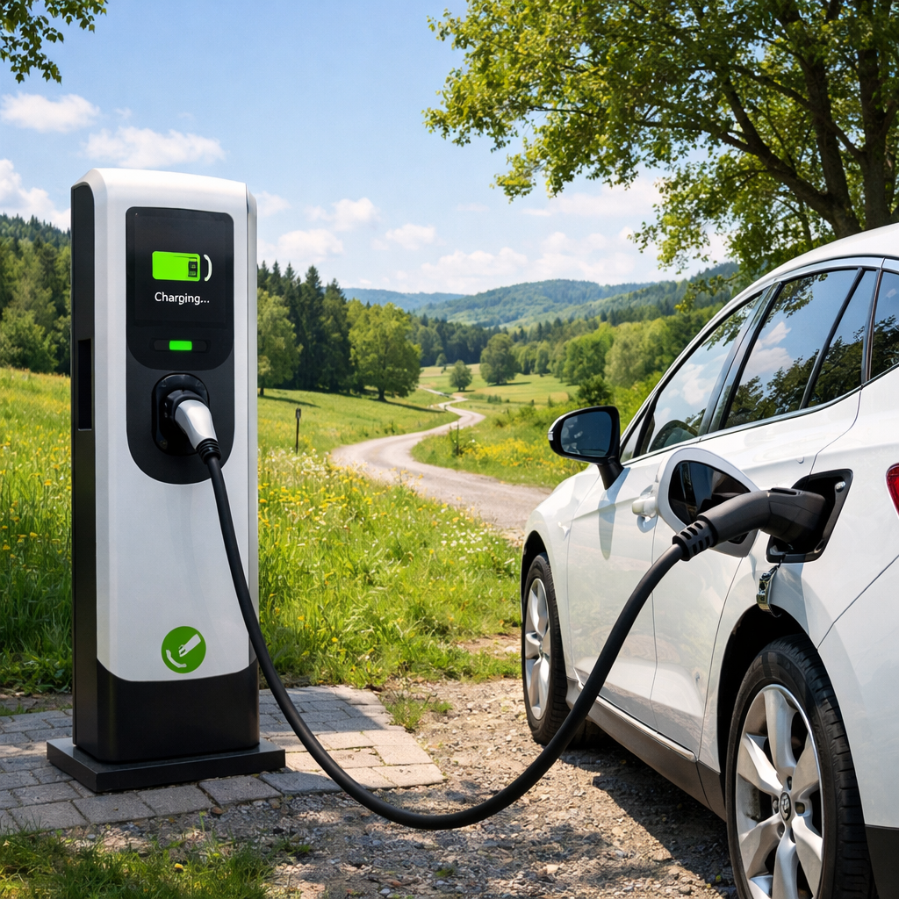
EV-CRA Charge with Compliance
EV Charging is no longer a niche Internet-of-broken-Things topic
EV Charging is now critical digital infrastructure
This talk is about architecture, not legal interpretation
CRA and NIS2 are treated as design constraints, not paperwork

Slide 3
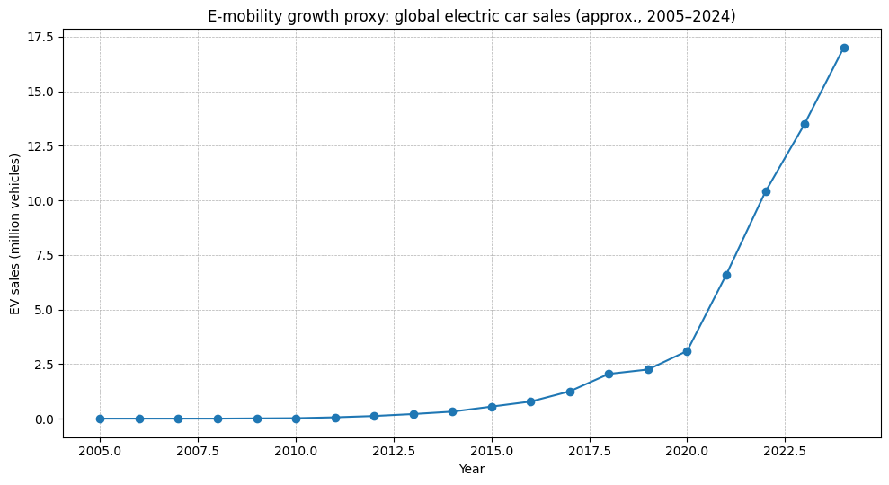
E-Mobility in a nutshell
Fast deployment, weak foundations, “ship-and-forget” mentality.
Security, resilience, updateability, lifecycle and auditability are all vendor-specific secondary concerns.
This created long-term technical debt.

Slide 4


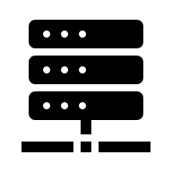





EV Operational Environments
PSD2
Smart Grid
CRA Death Valley
?!
Local
Controller
CSMS
EV Roaming
E-Mobility Provider
User A
User C
Direct User
Roaming User
CRA
UNECE R 155 / UN Regulation No. 155
Charging
Station
?!
User B
ISO 15118 User

Slide 5
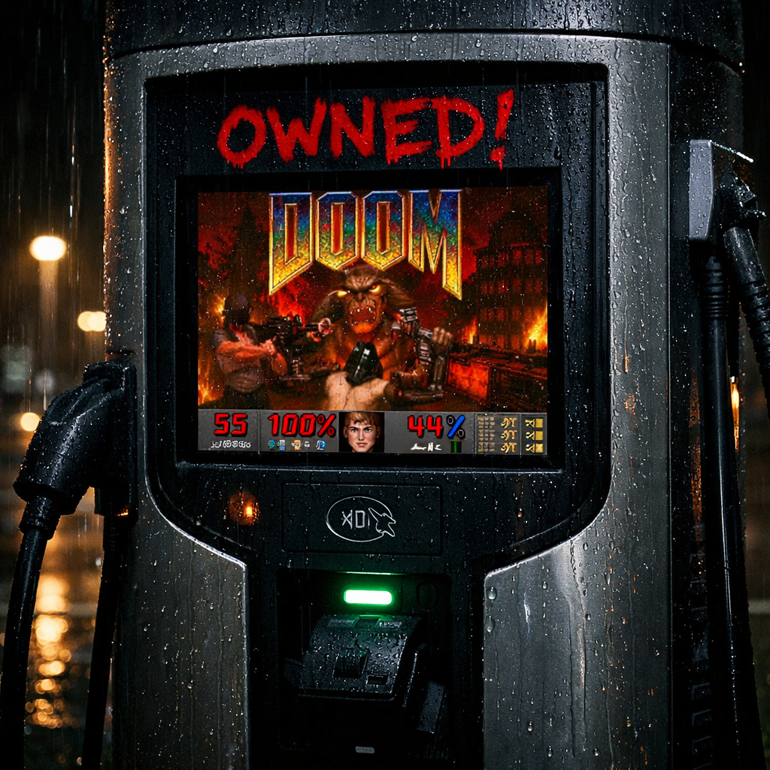
When specs fail to produce trust
RFID/AutoCharge ~Secure technology, insecure context/environment
German Calibration Law (Eichrecht) Formal compliance, no driver benefits
ISO 15118 Cryptography on the charging cable… only
EU Radio Equipment Directive (EU RED) Manufacturers prefer to disable features, instead of securing them!

Slide 6
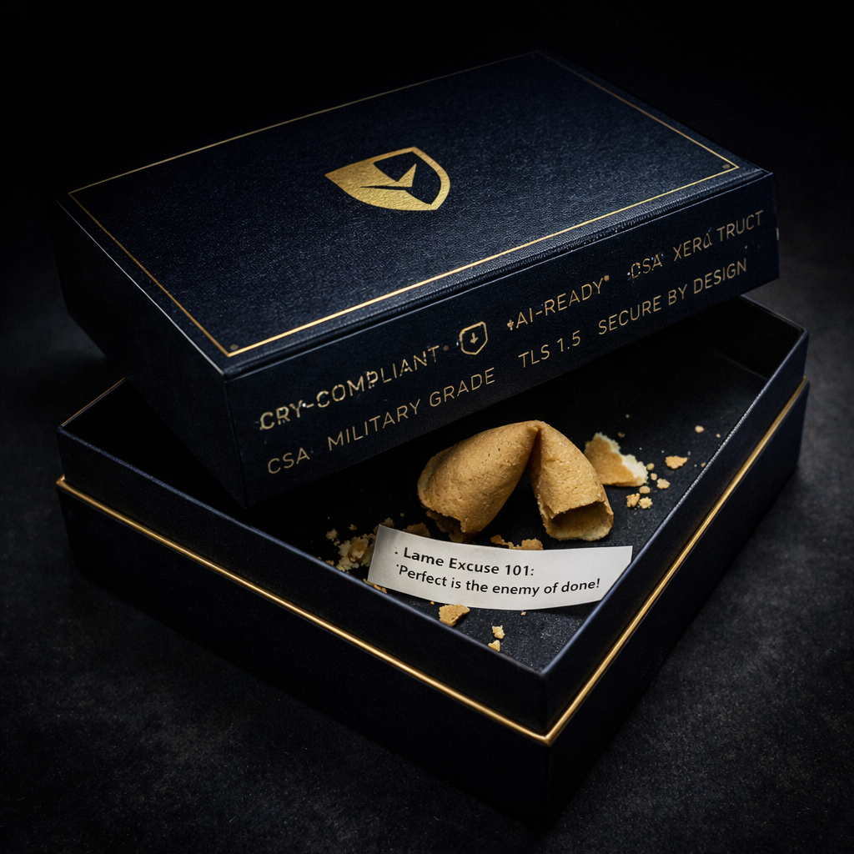
When specs fail to produce trust
Security ≠ Deployed Security
Compliance ≠ Trust
Intent ≠ Evidence
Once released, specs ossify asap and lame manufacturer excuses take over.

Slide 7

Regulation becomes design input
Security & Resilience are no longer “best effort”.
Both must be designed in and provable.
Regulations now constrain architecture, product lifecycle development and day-to-day operations.

Slide 8

Uncomfortable questions for engineers
What must be enabled/disabled by default?
What must be observable?
What must be provable years later?
Ad-hoc answers don’t scale!

Slide 9

The uncomfortable reality for regulators
Security & resilience are cross-manufacturer obligations, not single manufacturer concerns.
CRA/NIS2 should be interoperable between manufacturers of the same product type, otherwise security & resilience often fails.
Inconsistent deployments increase systemic risk under NIS2.

Slide 10



Open-Source Protocols as compliance surfaces
Products & services implement some open-source management protocol, e.g. Open Charge Point Protocol by the Open Charge Alliance (a CRA OSS Steward?)
Protocol encodes key assumptions, syntax, behavior, message formats, state machines, error semantics, …
Defaults matter more than options
Missing primitives → incompatible vendor hacks
https://nlnet.nl/project/EVQI/

Slide 11
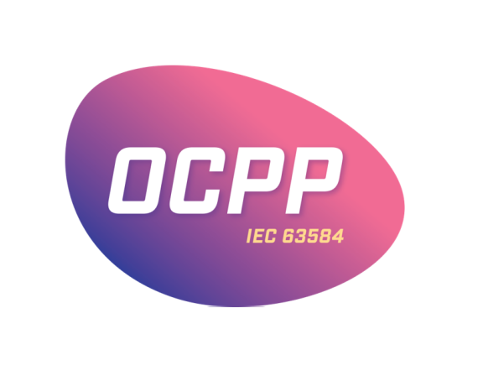

Technical specs break under regulation
Same protocol, too many roles.
Same protocol, very different acceptable risks!
Regulations care about what runs in production, not what’s somehow “possible”.
Protocol ≠ deployment
Mechanics ≠ responsibility

Slide 12

Security Operations Guide
Narrows down the protocol specification for the given use case in the given operational environment.
Anchors operational duties.
Describes risks, mitigations, defaults, observable controls, evidence expectations (~90% of obligations).
Keeps interoperability stable, while allowing security and resilience to evolve.
https://openchargealliance.org/ocpp-info-whitepapers/security-operations-guide/

Slide 13
A horizontal blueprint for vertical standards
User / Operator
Product
Manufacturer
UC1, OE1, UC2, OE2
Product A1
Manufacturer A
Security Operations Guide
User / Operator
Open Source Protocol
Product B1 (OE1)
Manufacturer B
Product B2 (OE2)

Slide 14
a CRA Article 25 “Voluntary Security Attestation Framework” from an OSS Steward?
A horizontal blueprint for vertical standards
User / Operator
Product
Manufacturer
UC1, OE1, UC2, OE2
Product A1
Manufacturer A
Security Operations Guide
User / Operator
Open Source Protocol
Product B1 (OE1)
Manufacturer B
Product B2 (OE2)

Slide 15
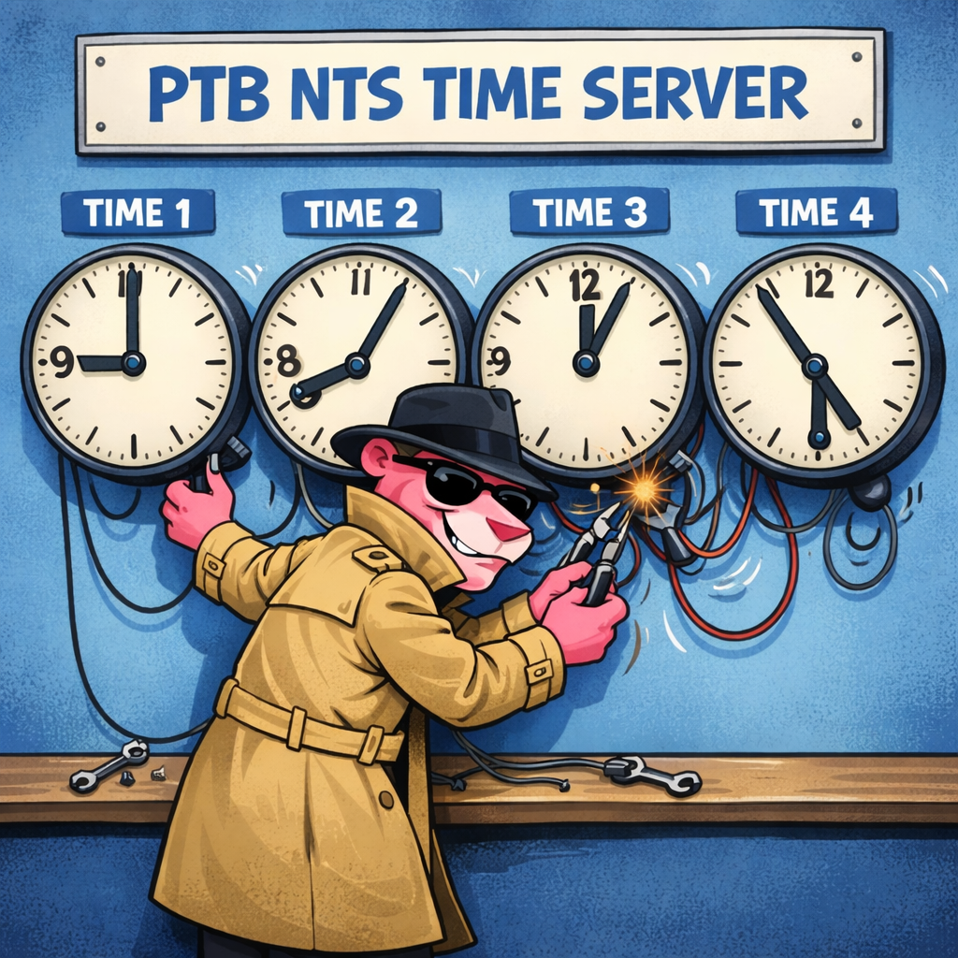
CRA / NIS2 lives outside our protocol stacks!
When we consume a product or a service our tooling, automation, and trust assumptions usually start on the TCP/IP networking layer: https://charging.station, https://ptbtime1.ptb.de
Governance, security, resilience, vulnerabilities, … remain out-of-band, non-machine-readable scattered across documentation, if mentioned at all.
Is this still acceptable for state-of-the-art digital infrastructure?

Slide 16
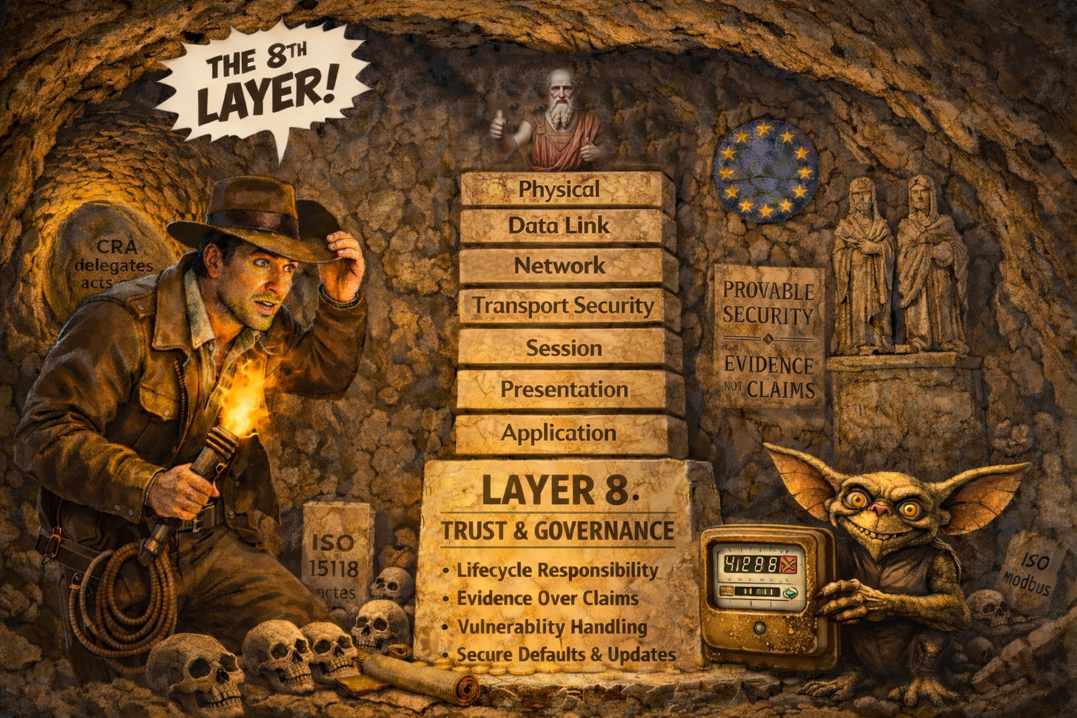
Notes:
Those three challenges will drive my presentation, the remain with us and they have just evolve

Slide 17
CRA product consuming a NIS2 service
No longer hardcoded/-configured service endpoints!
https://ptbtime.ptb.de/.well-known/nts-policy.json
Whether DNS SRV/SVCB and DANE shall be used
Service Description and General Contact Information
Service Quality Metrics: minServers, maxDelay, …
Links to Historic Service Quality Data
Links to Vulnerability Information / Reporting
Links to Planed Service Times / Issue Management
Digital Signatures, Lifetime Information, …
Buzzword: “Digital Service Passport”

Slide 18

CRA product exposed information
In error reports context is always missing/wrong
CRA device shall provide governance meta data via its firmware and management protocol
Product Description and General Contact Information
Links to Vulnerability Information / Reporting
Links to Firmware Updates / Editions
Buzzword: “Digital Product Passport” with CRA extensions

Slide 19

CRA product exposed information with context
CRA devices shall expose the “layer 8 governance meta data” from each (NIS2) service it is consuming.
This enables more efficient error reports, as all context information is directly available.

Slide 20
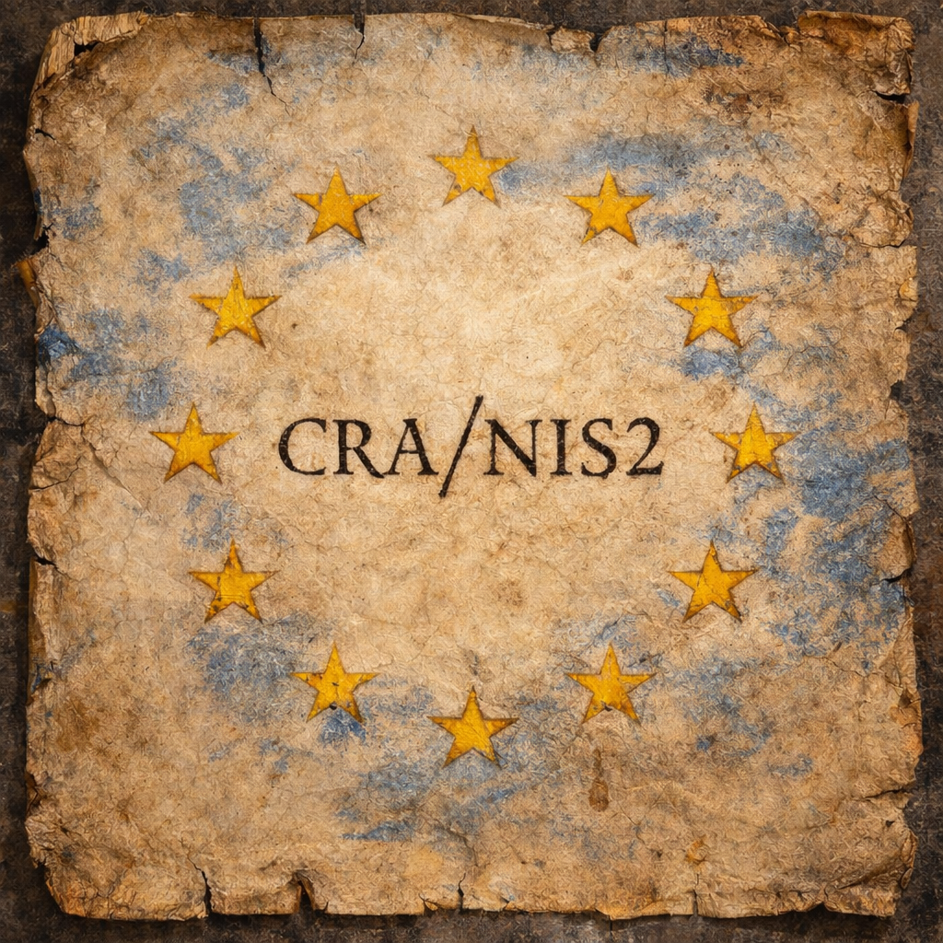
Conclusions…
Open Source Protocols should become CRA Stewards.
Split your protocol in a Technical Base Layer and a Security Operations Guide.
Provide Governance Meta Data of all your services and products via “Platon’s Layer 8”
Consume governance meta data to improve resilience, security, user-friendliness and your own service level.

Slide 21


